Slide 1





Introduction to Robotic Process Automation
SALARY
INCREMENT
SYSTEM
220701187
Nishal I P
Mrs G.M Sasikala
Computer Science and Engineering

Slide 2
Abstract
The "Automated Salary Increment Notification System Using UiPath" is an innovative project designed to streamline the process of salary updates and employee notifications within organizations. Traditional salary management and communication workflows often involve manual interventions that are time-consuming, error-prone, and inefficient. This project leverages Robotic Process Automation (RPA) to automate the entire workflow, from calculating salary increments based on departmental criteria to notifying employees via personalized emails. By using UiPath as the core automation platform, this system eliminates redundancy and enhances operational efficiency, allowing HR professionals to focus on strategic activities instead of repetitive tasks.

Slide 3
Need for the Proposed System
The proposed "Automated Salary Increment Notification System" addresses several critical challenges faced by organizations during the salary appraisal process. These challenges highlight the necessity for an automated system to streamline operations, improve accuracy, and enhance employee communication.
Elimination of Manual Errors: Manual salary calculations are prone to errors, especially when dealing with large datasets. Mistakes in increments or data handling can lead to employee dissatisfaction and operational inefficiencies. The proposed system automates the entire process, ensuring accurate and consistent salary updates.
Time and Resource Efficiency: The traditional process of calculating salary increments, updating records, and notifying employees is time-consuming and requires significant manpower. The automated system drastically reduces processing time, allowing HR teams to focus on more strategic tasks.
Improved Employee Communication: Sending personalized salary updates to employees manually can be tedious and inconsistent. The proposed system ensures timely, professional, and uniform communication with employees, fostering transparency and trust.

Slide 4
Main Objective
The primary objective of the "Automated Salary Increment Notification System" is to streamline and automate the process of managing employee salary increments and notifications. By leveraging robotic process automation (RPA) through UiPath, the system aims to eliminate manual errors, reduce processing time, and enhance communication with employees.
Specifically, the system is designed to:
Accurately apply department-specific salary increments to employee data.
Update and store the processed salary details efficiently in a new Excel file.
Automate personalized email notifications to employees with their updated salary information and motivational messages.

Slide 5
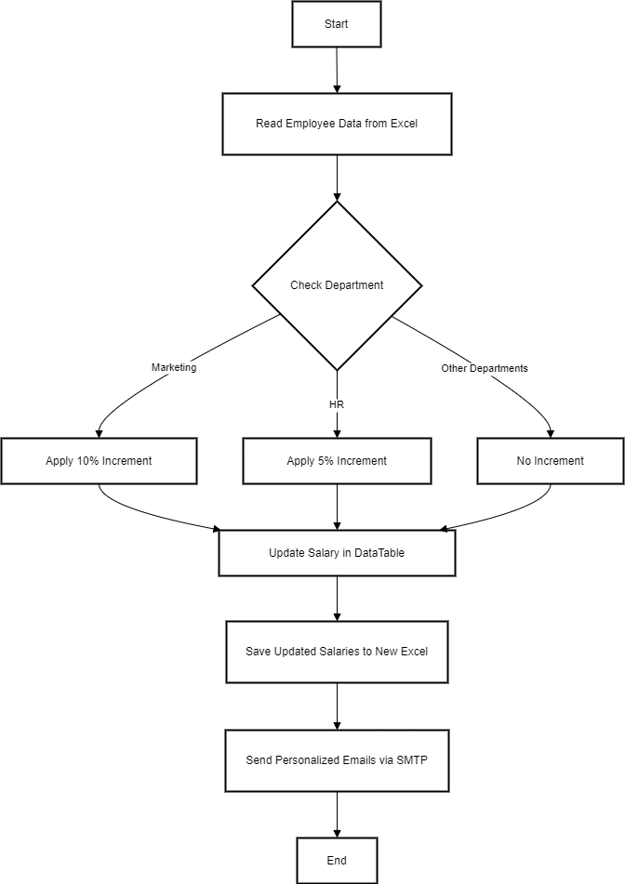
Architecture

Slide 6
System Requirements
Hardware Requirements:
Processor: Intel i3 or higher (recommended Intel i5 or above).
RAM: Minimum 4 GB (8 GB recommended for optimal performance).
Storage: At least 10 GB free space.
Internet: Stable connection .
Software Requirements:
RPA Tool: UiPath Studio (Community or Enterprise edition).
Browser: Google Chrome with UiPath extension installed.
Data Source: Microsoft Excel or other structured data formats.
Operating System: Windows 10 or later (64-bit)

Slide 7
Functional Description
The "Automated Salary Increment Notification System" is a comprehensive solution that automates the salary increment process, ensuring accuracy, efficiency, and timely communication with employees. The system is designed with the following key functionalities:
1. Data Input Handling
Reads employee data from an Excel file containing details such as names, departments, salaries, and email addresses.
The system loads this data into a DataTable for processing, ensuring a structured and efficient workflow.
2. Increment Calculation
Applies department-specific salary increment rules:
Example: 10% increment for Marketing, 5% for HR, and no change for other departments.
Loops through each employee record to calculate the new salary based on the predefined rules.
Updates the salary field in the DataTable with the incremented values.

Slide 8
Functional Description
3. Data Output Management
Writes the updated employee data, including incremented salaries, to a new Excel file named UpdatedSalaries.xlsx.
Ensures data integrity and accuracy in the output file for HR records.
4. Email Notification
Automatically sends personalized emails to employees using their email addresses from the data.
Each email includes:
The employee's name.
Their updated salary.
A motivational message congratulating them on their increment.
Uses SMTP for seamless and secure email delivery.

Slide 9
Process Design
The "Automated Salary Increment Notification System" follows a structured design to automate the salary increment and notification workflow. Below is the step-by-step process design:
1. Input Handling
Reads employee data from an Excel file and validates required columns like Name, Department, and Salary.
2. Salary Increment Calculation
Applies department-specific increment rules and updates the "Salary" column in the DataTable.
3. Output Data Handling
Saves the updated employee data into a new Excel file named UpdatedSalaries.xlsx.
4. Email Notification
Sends personalized emails to employees with their updated salary details using SMTP.
5. Error Handling
Manages errors with Try-Catch and logs issues for further resolution.
6. Reporting
Logs the number of processed employees and generates a summary report.

Slide 10
Implementation
The implementation of the Automated Salary Increment Notification System involves integrating UiPath's robotic process automation capabilities to streamline the salary management workflow. The system begins by reading employee data from an Excel file and applying department-specific salary increment rules using automation logic. The updated salaries are saved to a new Excel file, ensuring accurate record-keeping. A personalized email notification is then sent to each employee, informing them of their revised salary with a motivational message. Error-handling mechanisms and logging ensure reliability, while the process is designed to be scalable and adaptable for organizations of various sizes.

Slide 11
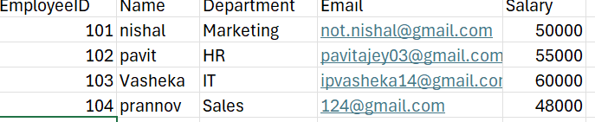
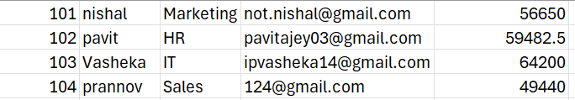
Testing
Screenshots
Input Excel File
Updated Excel File

Slide 12
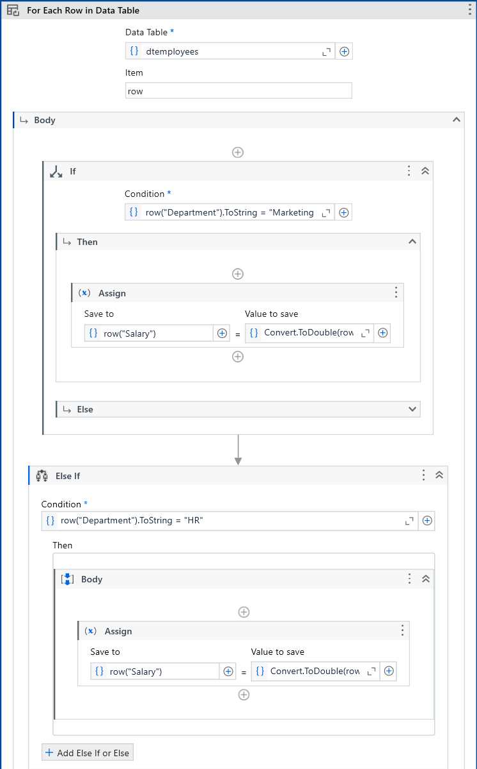
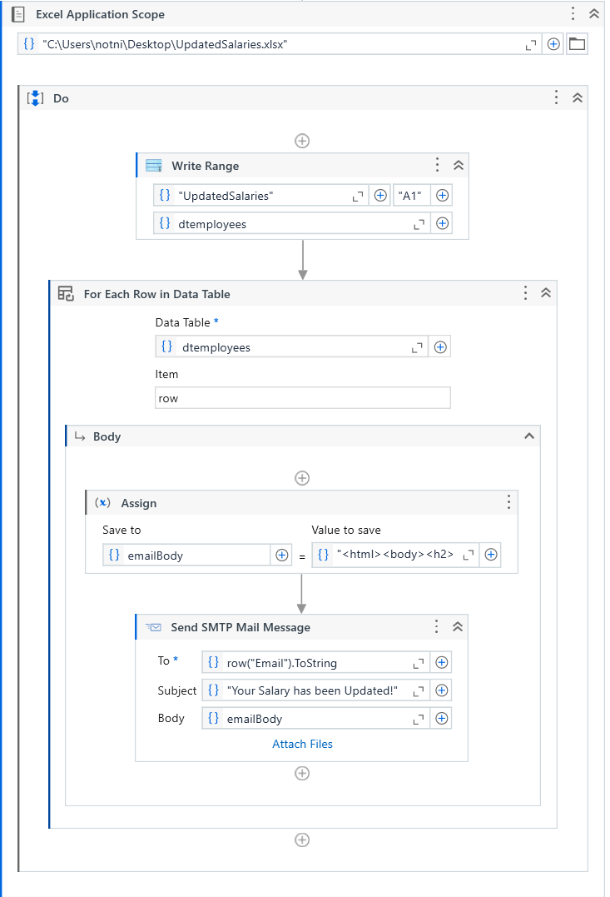
Screen Shots

Slide 13
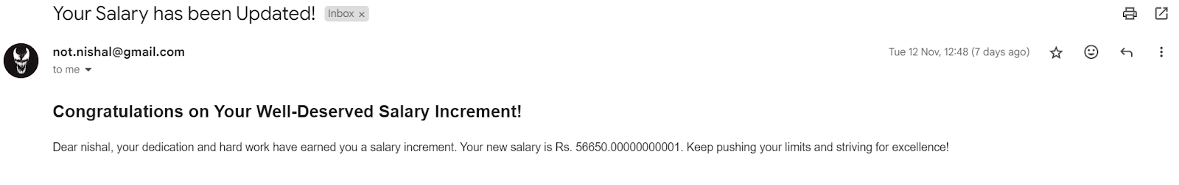
Testing
Screen Shots
Increment Email

Slide 14
Conclusions
The Automated Salary Increment Notification System provides a robust and efficient solution for handling salary increments and notifications within organizations. By leveraging robotic process automation (RPA) through UiPath, the system automates key tasks such as data processing, salary calculations, and employee communication, significantly reducing the risk of human error and saving valuable time. It ensures accuracy in applying department-specific increments, offers scalable solutions for businesses of all sizes, and provides employees with clear and timely notifications. Furthermore, the system is adaptable, with future enhancements like HR system integration, mobile support, and tax calculations, making it a forward-looking solution. Ultimately, this system streamlines HR workflows, enhances employee satisfaction, and contributes to overall organizational efficiency.

Slide 15
Future Enhancement
The Automated Salary Increment Notification System can be expanded and improved in the future with the following enhancements:
Integration with HR Management Systems: Directly integrate the system with HR platforms like SAP or Workday for real-time data synchronization and updates.
Multi-Language Email Support: Enable email notifications in multiple languages to cater to diverse employee demographics across global organizations.
Enhanced Security Features: Incorporate advanced encryption techniques to ensure the confidentiality and security of employee data during processing and communication.
Performance Analytics Dashboard: Add a dashboard to provide real-time insights into processed data, employee statistics, and error logs for better decision-making.
Mobile Application Integration: Extend functionality to mobile platforms, allowing employees to view their salary updates and notifications on the go.

Slide 16
References
UiPath, "UiPath Studio - Official Documentation," Available at: https://docs.uipath.com.
Accessed: November 2024.
S. Avasarala and M. Gopalan, "Robotic Process Automation: A Survey," International Journal of Advanced Research in Computer Science and Software Engineering, vol. 7, no. 5, pp. 43-51, 2017.
S. J. Roy, "Automating Business Processes Using UiPath," International Journal of Computer Applications, vol. 179, no. 10, pp. 30-36, 2019.
Microsoft, "Excel - Official Documentation," Available at: https://support.microsoft.com/en-us/excel.

Slide 17
Queries

Slide 18
Demonstration

Slide 19
Thank You

